Slide 1
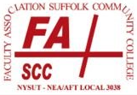
Planning for Retirement
Fall 2023
Faculty Association of
Suffolk Community College
Financial Counseling Benefit
Stacey Braun Associates, Inc. is the provider of the FASCC Financial Planning Benefit

Slide 2









Planning for Retirement: Sub-Topics
Defining Retirement
How Much Will You Need?
Pension/ORP
Social Security
Investments
Insurance
Taxation
Estate Planning
Financial Assistance

Slide 3

Define Retirement Goals
Define Retirement Goals
What does retirement mean to you?
Age at retirement
Where will you live?
What debt will you have?
What will you do? (travel, hobbies, etc.)
What will your lifestyle be?
Your job is to determine how you want to live in retirement and are job is to make sure you have the money to do it!

Slide 4

What is Your Net Worth?
How Much Will You Need?
Take a “snapshot” of your finances:
Everything you own is considered an Asset
Everything you owe is considered a Liability
Assets
- Liabilities
= Net Worth
Everyone should know a starting point in order to develop a plan!

Slide 5

Retirement Expenses
How Much Will You Need?
Adjust current budget for changes due to retirement:
Expenses that will no longer exist
New expenses
Taxes
Inflation will remain an important factor.
Income less Expenses = Surplus or Deficit

Slide 6

Retirement Income
How Much Will You Need?
Pension
Social Security
Retirement Savings:
  Savings and Brokerage Accounts
  401(k), 403(b), and/or 457(b) Accounts
  IRAs

Slide 7


Retirement Accounts
Retirement
Employer & Employee Funded
  NYSTRS (Defined Benefit)
  Optional Retirement Plan (Defined Contribution)
(Employee has the option to choose one plan at onset of employment)
Employee Funded
  403(b) Supplemental Retirement Plan
  457(b) Deferred Compensation Plan

Slide 8

How Your Pension is Calculated
NYS Pension
A New York State Pension is a “Defined Benefit” Plan
 | TIER 4 | TIER 5 | TIER 6
Date | 9/1/83 - 12/31/09 | 1/1/10 - 3/31/12 | On or After 4/1/12
Retirement Age | 62 | 62 | 63
Early Ret Age (w/ 30 yrs) | 55 | 57 (TRS) / 62 (ERS) | 63
FAS | 3 highest consecutive years |  | 5 highest consecutive years
Factors | 1.67% (up to 20 yrs) | 1.67% to 25 yrs (TRS) / to 20 yrs (ERS) | 1.67% up to 20 years
 | 2.00% (20-30 yrs) | 2.00% 25-30 yrs (TRS) / 20-30 yrs (ERS) | 1.75% at 20 years
 | 60% + 1.50% every year after 30 | 60% + 1.50% every year after 30 | 35% + 2.00% every year after 20
Contributions | Complete (was 3% first 10 years) | For Career: 3.5% (TRS) / 3.0% (ERS) | For Career: 3.0%-6.0% based on salary

Slide 9

Pension Election Options
NYS Pension
Single Life
In highest amount, payable to the pensioner for life.
Joint
In a reduced amount, payable until the second-to-die of pensioner and another individual (the “beneficiary”).
Pop–Up
In slightly smaller amount, initially like Joint - but “pops up” to the highest Single amount for pensioner if pensioner survives the beneficiary.
5- or 10-Year Certain
Payable to pensioner for life, but payable to a beneficiary if pensioner fails to outlive a 5- or 10-year term.

Slide 10
Pension Example: Single vs. Joint vs. Pop-Up
Retirement
Hypothetical 62-year-old Tier 4 Employee: 30 YOS, $100,000 FAS / Spouse is 57

Slide 11

Factors to Consider
NYS Pension
Decision is irrevocable!
Assume a worst-case scenario.
Does spouse/beneficiary have a pension?
What other assets would be available?
Elect “Single” and protect beneficiary with life insurance?
Prior to retirement, meet with TRS Pension counselor and obtain your personal projections.

Slide 12

Whatever the Choice–Good News!
NYS Pension
A Pension often replaces a meaningful percentage of a retiree’s final-year pay.
Example:
Single, Tier 4 Member
Defers 10% to Retirement Plan
$100K FAS, 30 YOS
Elects “Single” Payout:
(2% x 30 x $100K = $60K)

Slide 13
Pension - ORP
Retirement
Optional Retirement Plan
Employee chooses ORP or TRS at onset of employment
Defined Contribution Plan
  Contributions are made by employee (based on Tier)
  Contributions are also made by employer (same as TRS)
  Invested by participant
  Subject to market fluctuations
  Account value available at retirement
Distribution Strategies
  Annuitize
  Interest Only
  Rollover
Other Factors
  TIAA Traditional Account

Slide 14
Social Security
Social Security
Social Security
When to Draw?
Earliest
Age 62
Latest
Age 70

Slide 15
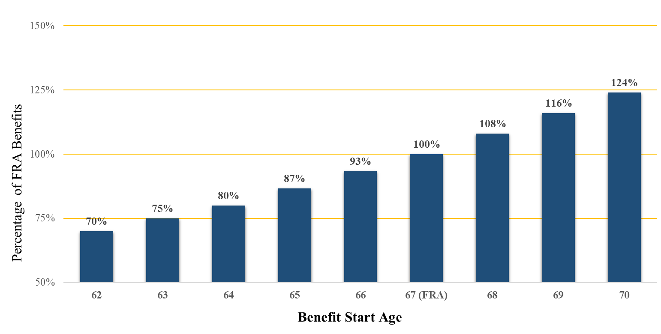
Social Security Payout Schedule
Social Security
Source: Social Security Administration (www.ssa.gov).
Chart assumes full retirement age of 67. Percentages at 65 & 66 rounded for simplicity.

Slide 16
If “Break-Even” is a Consideration…
Social Security
62
70%
of PIA
67
100%
of PIA
70
124%
of PIA
Age 82.8
Age 78.7

Slide 17

Considerations
Social Security
  Will you work before FRA?
  How is your health?
  Is there an expectation of longevity?
  Are you married?
  What is your age differential?
  Whose benefits can a spouse collect?

Slide 18



IRS Tax Code Determines Type of Plan
Retirement Accounts
401(k)
403(b)
457(b)
Company Plans
Apple
Pfizer
Stacey Braun
Non-Profit Plans
Schools
Hospitals
Charities
Government Plans
Townships
Counties
States

Slide 19

Defined Contribution Plans
Retirement Accounts
401(k) / 403(b) / 457(b) Plans:
  Employee invests portion of compensation via payroll deductions
  Employee-directed investments grow tax-deferred
Pre-Tax (Traditional) and Post-Tax (Roth) options
The IRS increased contribution limits for 2023:
  $22,500 - anyone
  $30,000 - anyone Age 50 or older
Congress also made 2023 changes:
  Required Minimum Distributions must now commence at Age 73
  RMD Age will become 74 (2029)
  RMD Age will become 75 (2033)

Slide 20

Asset Classes and Investment Choices
Investments
Cash
  Liquidity, emergency fund, short-term needs
  (0-3% average Annual Return)
Bonds
  Income, safety, stability, modest growth
  (2-6% average Annual Return)
Stocks
  Long-term investing, growth over time but with volatility
  (8-12% average Annual Return)
General Guidelines
Understand risk/reward propositions of each asset class.
The closer you are to needing funds, the safer those funds should be.
Maintain discipline and diversification.
Rebalance a portfolio as necessary.

Slide 21

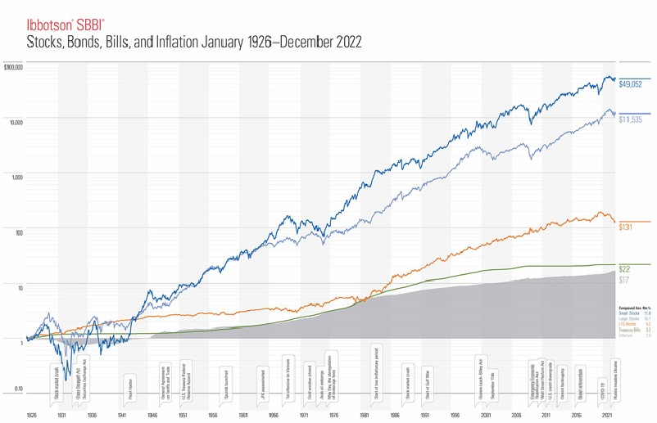
SBBI: Stocks, Bonds, Bills & Inflation
Investments

Slide 22
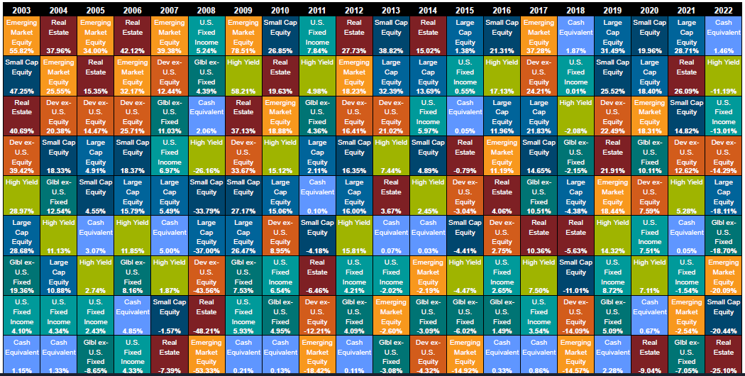
The Callan "Periodic Table" of Investment Returns
Investments
  A Color-Coded “League Standings Table” of how various Asset Classes have fared versus each other.

Slide 23

A Word on Trying to Time the Market
Cash Management
  Timing error can have severe consequences.
  20-Year Growth of $10,000 invested in the S&P 500 (2003-2022)
  (Approximately 4800 Trading Days)

Slide 24

Evaluate Insurance Coverage
Insurance
Evaluate/Revisit types and amounts of Insurance:
Life
Short/Long-Term Disability
Long-Term Care

Slide 25

Taxation of Retirement Income
Taxation
Pension:
100% federally taxable. No NYS tax.
Social Security:
Up to 85% federally taxable. No NYS tax.
Retirement Accounts:
100% federally taxable. $20,000 annual NYS exclusion if over 59 1/2.
IRS Required Minimum Distributions (“RMDs”)
Now commence at age 73 from all Pre-Tax accounts.

Slide 26
Tax-Friendly States
Taxation
New York
Alabama
Alaska
Florida
Hawaii
Illinois
Mississippi
Nevada
New Hampshire
Pennsylvania
South Dakota
Tennessee
Texas
Washington
Wyoming

Slide 27


Why Estate Planning is Needed
Estate Planning
Estate Planning
Ensures intentions are honored
Governs distribution of property
Appoints individuals to manage estate
Designates guardians for minors
Provides liquidity

Slide 28

Estate Planning/Documents
Estate Planning
Estate Planning
How property transfers:
Beneficiary Designations – Acounts, Insurance, etc.
Trusts & Transfer on Death (TOD/POD) Accounts
Jointly Held Property
Will
Documents Needed:
Will
Power of Attorney
Health Care Proxy
Living Will

Slide 29

Financial Assistance
Financial Assistance
Be thorough when hiring a Professional Advisor:
  CFP® or other credentials can help identify qualifications
  Understand how planner earns compensation (fees vs. commissions)
  Understand planner’s scope of services
  (e.g., tax advice, portfolio recommendations)
  Is the planner a fiduciary?

Slide 30

Roadblocks to Financial Success
No Goals
Lack of Preparation/Incomplete Understanding
Excessive Debt
Poor Investment Choices
Inflation
Taxation
Procrastination

Slide 31

Helpful Tips
Take a financial snapshot
Use it to set goals
Determine in-retirement lifestyle and expenses
Make sure debt is under control or paid off
Ensure assets are invested according to a plan
Obtain your Social Security benefit projection
Obtain a Pension projection and meet with a TRS Pension counselor
Protect your assets (insurance, trusts, etc.)
Ensure affairs are in order (estate documents, beneficiary designations, etc.)
Meet with a financial counselor (Stacey Braun)

Slide 32

Features of the FASCC Financial Planning Benefit
Free financial consultations to discuss almost any financial issue or topics.
Expert advice provided by Certified Financial PlannersTM.
Receive only unbiased, objective advice—no investment or insurance products are sold.
Unlimited access to website and email helpdesk resources.
Complimentary webinars.

Slide 33

Thank You!
Stacey Braun Associates, Inc. is the provider of
Faculty Association of Suffolk Community College Financial Planning Benefit
www.staceybraun.com
(888) 949-1925

